Slide 1


Soputhik SENG
05/23/2023

Slide 2

Outline
Executive Summary
Introduction
Methodology
Results
Conclusion
Appendix

Slide 3
Executive Summary
Summary of methodologies
Data Collection via Rest API
Data Collection via Web Scraping (Wikipedia)
Data Wrangling
Exploratory Data Analysis with Data Visualization
Exploratory Data Analysis with SQL
Interactive Map with Folium
Interactive Dashboard with Dash
Predictive Data Analysis
Summary of all results
Results produced from EDA shows conclusive insight on the Falcon9 launches
Results produced from Interactive dashboard
Predictive Analysis Models that are able to predict the Success Rate of each launch with 83.33% accuracy

Slide 4
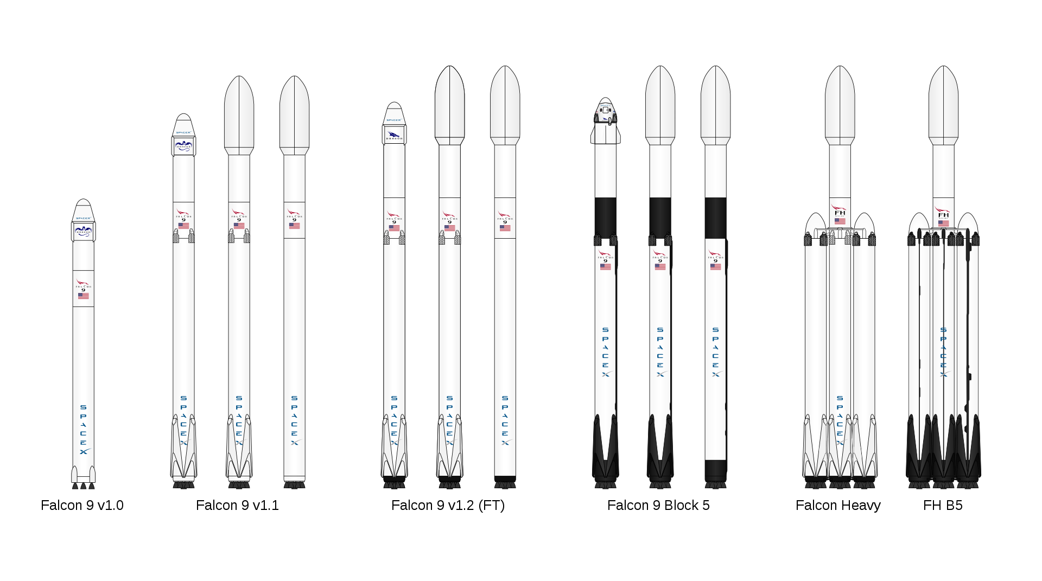
Introduction
Background and Context:
SpaceX was able to develop a major breakthrough in reducing the cost of space launches through reusable rockets. Although other companies are also experimenting with this technology, SpaceX has by far the most advanced and well-known solution towards the issue. Since this part of the launch will heavily reduce the costs involved, we would like to be able predict whether the first stage Falcon rockets would be able to land or not.
Problem we want to find answers:
We want to predict whether a launched Falcon Rocket would be able to successfully land.

Slide 5

Section 1

Slide 6
Methodology
Executive Summary
Data collection methodology:
Data was collected using the SpaceX API in addition to Web Scraping from Wikipedia
Perform data wrangling
The Data was first checked for Null Values, which was dealt with accordingly, we then reduce the data features on landing outcomes to better visualize the success rate
Perform exploratory data analysis (EDA) using visualization tools such as Seaborn, Matplotlib and SQL
Perform interactive visual analytics using Folium and Plotly Dash
Perform predictive analysis using classification models
We used the Wrangled data and split into train and test set before training it using multiple models to find out that all models work similarly on the data.

Slide 7
Data Collection
There were two main sources of the data that was used for our models
One of the data was achieved through the SpaceX API where we extracted it by calling specifically to the Rest API using a series of helper functions to be able to extract every single data that is useful for our model.
The other data set was done through Web Scraping on the Wikipedia site to get additional data that were not included in the SpaceX API such as the booster landing outcome, payload mass, and more.

Slide 8
Data Collection – SpaceX API
We created a GET request towards for the SpaceX API then with the help of a few helper functions we imported the necessary data into a Pandas DataFrame before exporting it into a CSV file.
Here is the link to the GitHub Data Collection Page
API CALL
SpaceX REST API CALL
GET DATA
Import and clean data
Export Data
Export to CSV

Slide 9
Data Collection - Scraping
Using the Beautiful Soup library, we were able to scrape the Wikipedia web page for the target table that we were looking which contains the data that we need. We then put it into a single Panda DataFrame before exporting it to a CSV file
Here is the link to the GitHub Web Scraping Page
Beautiful
Soup
BeautifulSoup library for scraping
Find Table
From the BS4 library we find the target table
Export Data
Export to CSV

Slide 10
Data Wrangling
To ensure that the data we have will provide the maximum information possible we need to clean the data in a way that the models could easily find the hidden patterns within.
We did this by
Exploring the data set looking for duplicates and null values. In our case we found that the LandingPad column has many null values.
We did EDA (Exploratory Data Analysis) on the data acquired we found that there were multiple categorical columns that needed to be converted. We did so by creating dummy variables for columns (Orbits, LaunchSite, LandingPad, Serial, and the most important feature which is ‘Class’ which is used for determining the success/failure of LandingOutcome.
Here are the links to the two pages where we completed Data Wrangling and EDA

Slide 11
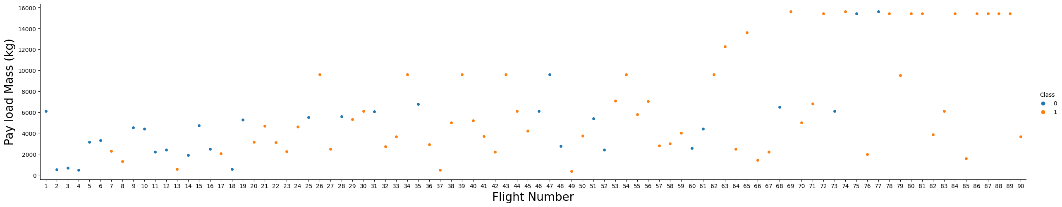
EDA with Data Visualization
There were a variety of plots that was used for visualization with EDA, each of it has its own uses and meaning, to help us better understand the data we have at hand, and to allow us to identify if there were any issues with our data.
The first chart that we plotted was a Scatter Plot showing all flights in relation to the Payload Mass that it carries as well as the Class of that flight of whether it had a positive outcome or not.

Slide 12
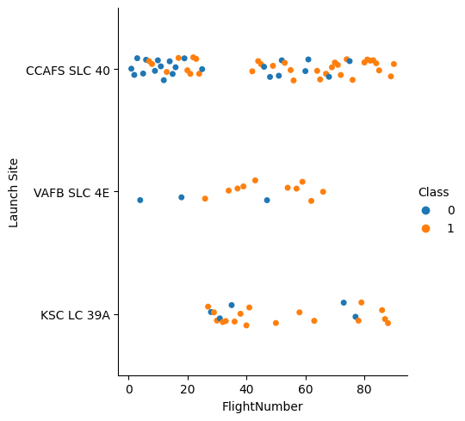
EDA with Data Visualization
The second chart that we plotted was another Scatter Plot that helps us identify the relationship between the flight number and each specific launch site on top of which also showing us the Class as the hue.

Slide 13
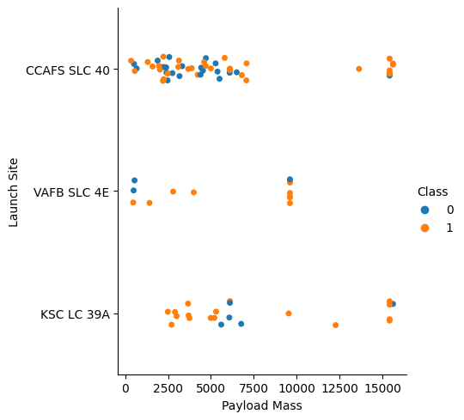
EDA with Data Visualization
The third chart that we plotted was another Scatter Plot that helps us identify the relationship between the Payload Mass and each specific launch site on top of which also showing us the Class as the hue.

Slide 14
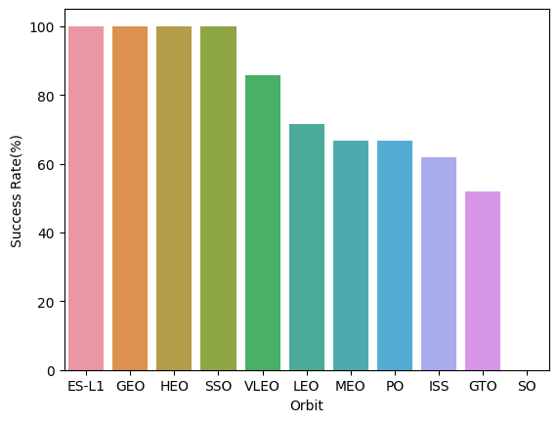
EDA with Data Visualization
The fourth chart that we plotted was a bar chart which compared the Orbit type towards its Success Rate

Slide 15
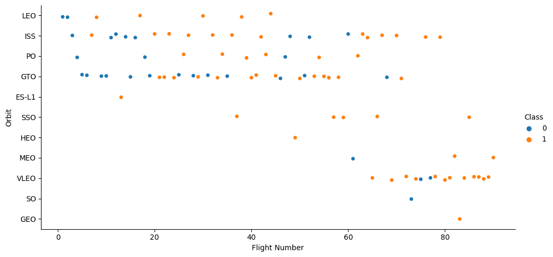
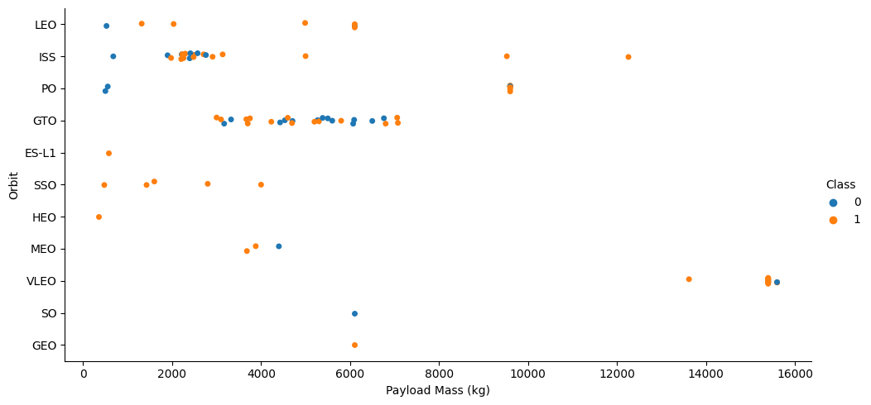
EDA with Data Visualization
The fifth and sixth plot represents the relationship of the Orbit type in relations to the flight number and payload mass with the hue as Class.

Slide 16
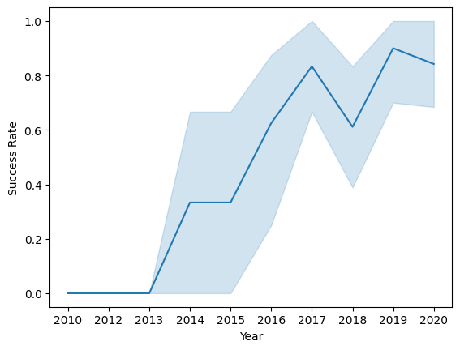
EDA with Data Visualization
The last chart that were plotted represented the success rate of all the launches throughout the years.
Here are the links to the page where we looked into and did EDA with Data Visualization on the data.

Slide 17
EDA with SQL
There were 10 total queries that we performed:
We first looked into the different launch sites that SpaceX had used to launch the Falcon 9
We then looked into the first five data of launches made from sites that started with ‘CCA’
Looked into the total Payload Mass that has been transport so far
The average Payload Mass carried by a specific booster version called “F9 v1.1”
The first date where a successful landing was carried out on a Ground Pad
List booster names that were able to carry Payload with a mass in between 4000 and 6000kg and successfully landed back on a drone ship
Summarize the number of mission that were considered as successful or failure
List all booster versions that were able to carry the maximum Payload mass
List failed Landing Outcome in the year 2015
Rank the successful landing outcomes within the time period of 04-06-2010 and 20-03-2017
Link to GitHub SQL EDA

Slide 18
Build an Interactive Map with Folium
We added a Folium Circle and Marker object on each launch site before then adding a marker cluster of each launches in each launch site, a Mouse Position is then added so that we are able to get the Latitude and Longitude the mouse is currently on, and last but not least we used the Mouse Position object to add lines onto the map displaying the distance between the launch site and the coast as well as some key infrastructures.
All of these object's aids in our ability to look at the key details on a map. It allows to easily understand and identify the positions of each launch site, its success rate, and how each launch site is chosen, especially with regards to the infrastructures within its vicinity and location.
Link to GitHub Folium Map Python Notebook

Slide 19
Build a Dashboard with Plotly Dash
There were two main graphs that were added to the dashboard, a pie chart and scatter plot. Each of these graphs also have an Input function in terms of a Dropdown filter and a slider to set filter data to what the viewer wants.
The plots helps viewers identify the launch site and its success rates while the scatter chart helps viewers identify the relationship between the Class with its Payload Mass, the drop down and the sliders aids in getting a better view of a more specific data set that we would like to retrieve, for example a data set of only the launch site KSC LC-39A of Payload between 4000 and 6000 kg.
Link to GitHub Python Plotly Dashboard

Slide 20
Predictive Analysis (Classification)
To create a model to predict the success of a Falcon 9 Launch, we first need import the data into a pandas DataFrame
Before we could do anything else, we need to divide the data into features set determined by X and the actual result which is determined by Y
We then scale and transform the features dataset X to ensure that the data is in a standardize form.
We then divide the into train test set using the train_test_split method
We set the test_size to 0.2 and the random_state to 2 to ensure every run will output the same result

Slide 21
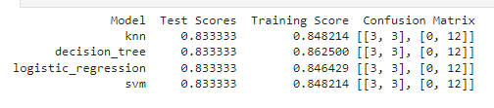
Predictive Analysis (Classification)
In total there were four different models that we had trained our data on. They are Classification Trees, SVM, Logistic Regression, and KNN (K Nearest Neighbor)
We used GridSearch with specific parameters for each models in order for it to be able to produce the best possible result using the cv=10 parameter.
Link to GitHub Predictive Analysis Notebook

Slide 22
Predictive Analysis (Classification) Flowchart
Import Data
Import cleaned data in pandas DataFrame
Divide Data
Divide data into X feature set and Y actual result set
Scale and Transform Data
Use Standard Scaler to transform data
Divide data
Divide data into train test set
Import Models
Import models from ScikitLearn
Use GridSearch
Use GridSearch to find the best parameters

Slide 23
Results
Exploratory data analysis results
Interactive analytics demo in screenshots
Predictive analysis results

Slide 24

Section 2

Slide 25
Flight Number vs. Launch Site
As you can see from the scatter chart you can see that the majority launches are made from Launch Site “CCAFS SLC 40”
The majority of the first 20 flights has a very small success rate, but as the flight number increases, the success rate starts to increase.

Slide 26
Payload vs. Launch Site
Most of the launches are made with a payload of around 7500 kg or less.
However, as the payload gets over 7500 kg, we see a higher success rate.

Slide 27
Success Rate vs. Orbit Type
Launches with payload going to the ES-L1, GEO, HEO, and SSO orbit all have 100% success rate.

Slide 28
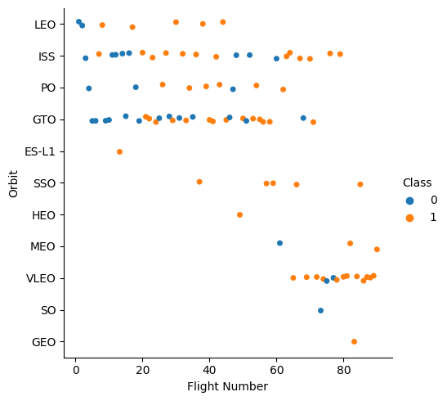
Flight Number vs. Orbit Type
We can see a lot of variety of the orbit types that SpaceX launches to, particularly only 4 of 11 types of orbit were only launched once.
SpaceX launched most of its payload to LEO, ISS, PO, GTO, and VLEO type orbit.

Slide 29
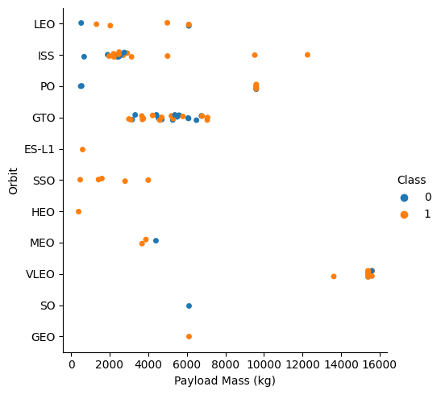
Payload vs. Orbit Type
Most of the payload being sent to orbit have a mass of less 8000 kg
Only the ISS, PO, and VLEO orbit type have send payload with masses of over 8000 kilograms to orbit.

Slide 30
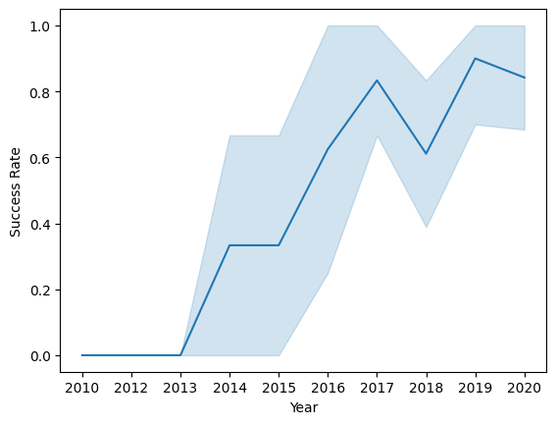
Launch Success Yearly Trend
At the beginning launches were very unsuccessful with a 0% rate
It started to increase as more flights and tests were made as it reached 80% in 2017.
There were a small dip in the success rate during 2018 but recovered to over 80 percent in 2019.

Slide 31
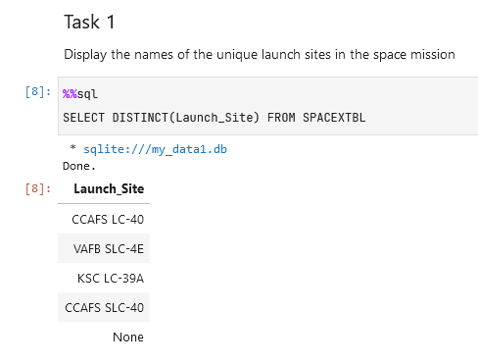
All Launch Site Names
There are 4 unique Launch Sites that SpaceX mainly uses for Falcon 9 launches mainly they are: CCAFS LC-40, VAFB SLC-4E, KSC LC-39A, and CCAFS SLC-40

Slide 32
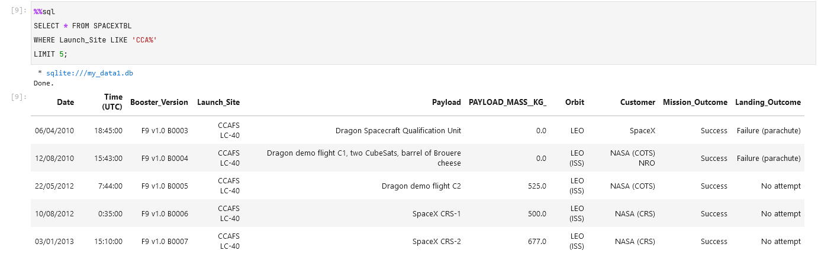
Launch Site Names Begin with 'CCA'
The first five launches made from the site that begins with CCA are as follows:
4 of which have NASA as the Customer, while the other being SpaceX

Slide 33
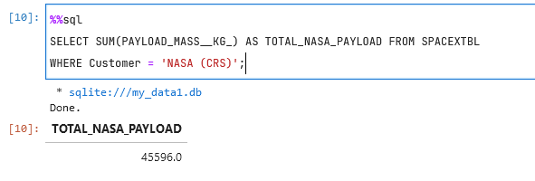
Total Payload Mass
The Falcon 9 has totally transported 45596 kilograms worth of payload during every single one of its missions.

Slide 34
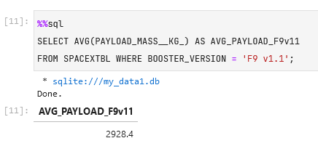
Average Payload Mass by F9 v1.1
Among the total 45596 kilograms worth of payload that was transported, 2928.4 kilograms was done so by the Falcon 9 v1.1.

Slide 35
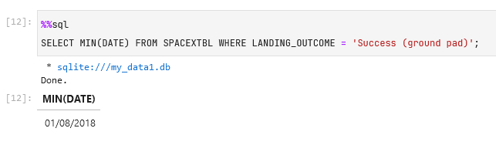
First Successful Ground Landing Date
The first successful landing on a ground pad was made on the 1st of August, 2018.

Slide 36
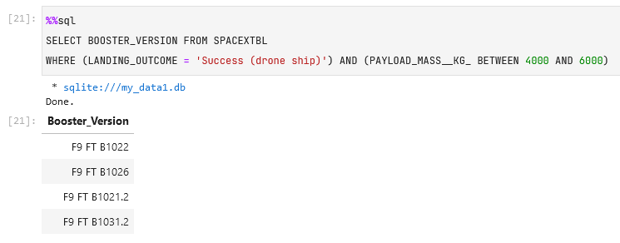
Successful Drone Ship Landing with Payload between 4000 and 6000
There were four different Falcon 9 versions that were able to successfully carry a payload of 4000 to 6000 kilograms and were then able to successfully land on a drone ship. They are F9 FT B1022, F9 FT B1026, F9 FT B1021.2, and F9 FT B1031.2.

Slide 37
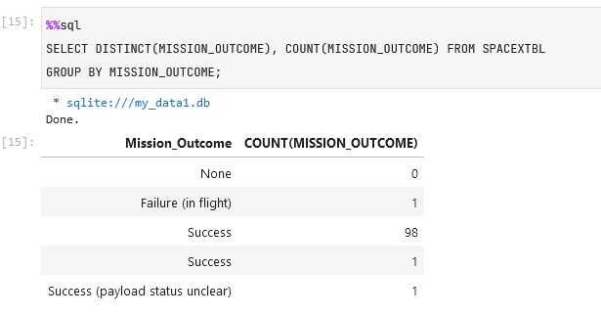
Total Number of Successful and Failure Mission Outcomes
Out of the total 101 launches, 100 were considered a success by SpaceX and only 1 were considered a Failure.

Slide 38
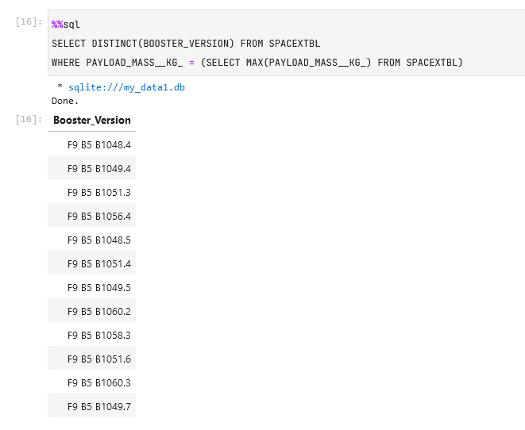
Boosters Carried Maximum Payload
There are totally 12 different Booster Versions that were able to carry the max payload, they are shown in the image to the right.

Slide 39
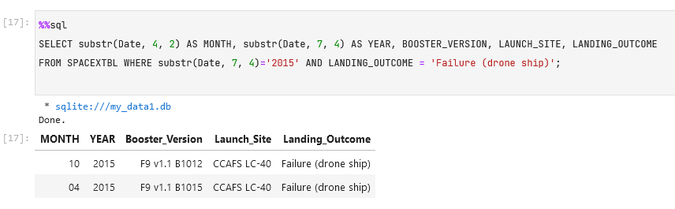
2015 Launch Records
There were two different landing failures when trying to land on the drone ship in the year 2015. Both launches were made from the Launch Site CCAFS LC-40.

Slide 40
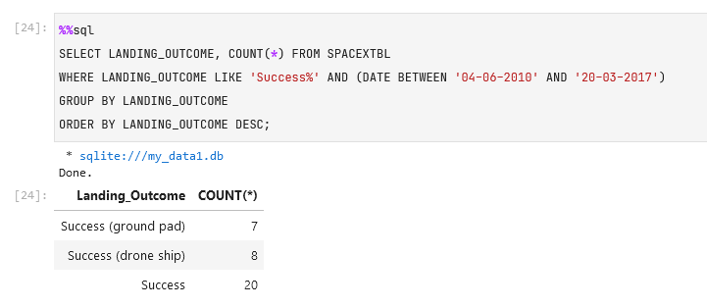
Rank Landing Outcomes Between 2010-06-04 and 2017-03-20
During the period, there were totally 35 successful launch outcomes, 7 on the ground pad, 8 on the drone ship, and 20 other success outcomes.

Slide 41

Section 3

Slide 42
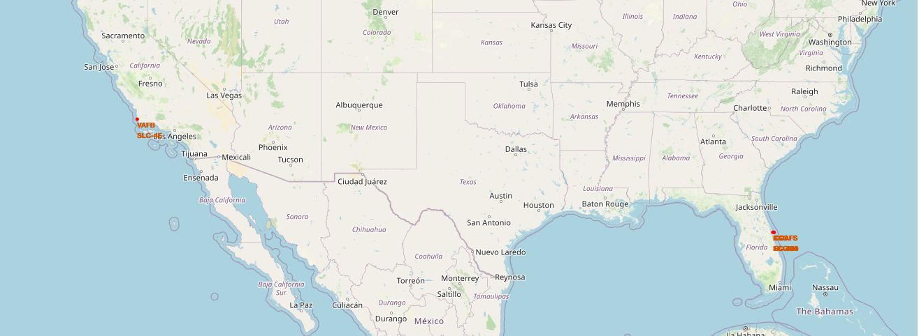
Launch Sites Location
There are four main launch sites, three were located on the east coast of Florida and one on the west coast of California. All sites also have proximity towards the equator.

Slide 43
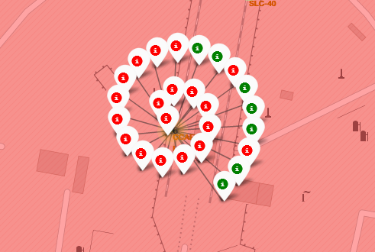
Success/Failure Launches on site CCAFS LC-40
Many of the launches made on the launch site CCAFS LC-40 fails. The site is located on the East Coast in Florida. There were a total of 26 launches.

Slide 44
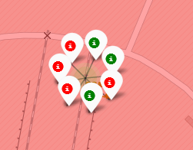
Success/Failure Launches on site CCAFS SLC-40
Many of the launches made on the launch site CCAFS SLC-40 succeeded, but there were a lot less launches with only 7 that were made here, although it is right next to CCAFS LC-40.

Slide 45
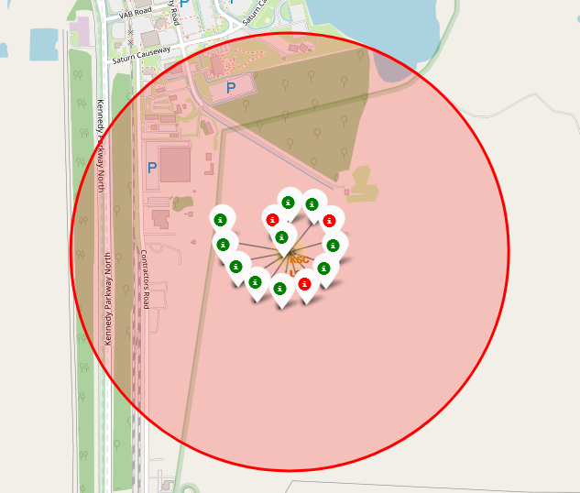
Success/Failure Launches on site KSC LC-39A
Another launch site in the vicinity of Florida, they were a total of 13 launches here the majority of which succeeded with only 3 failures.

Slide 46
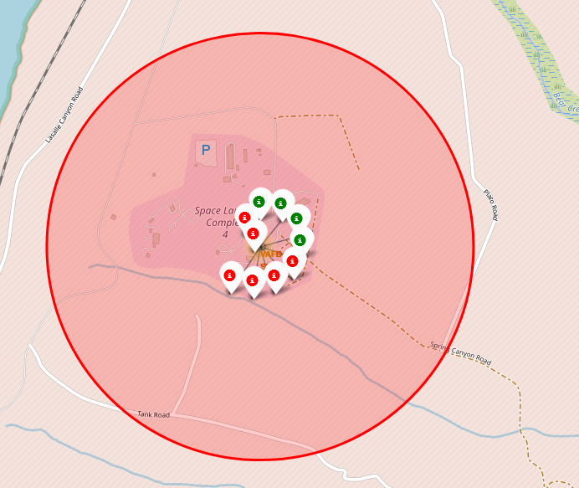
Success/Failure Launches on site VAFB SLC-4E
Contrary to the rest, this site is located on the West Coast, in California. There were totally 10 launches here with a 40% success rate.

Slide 47
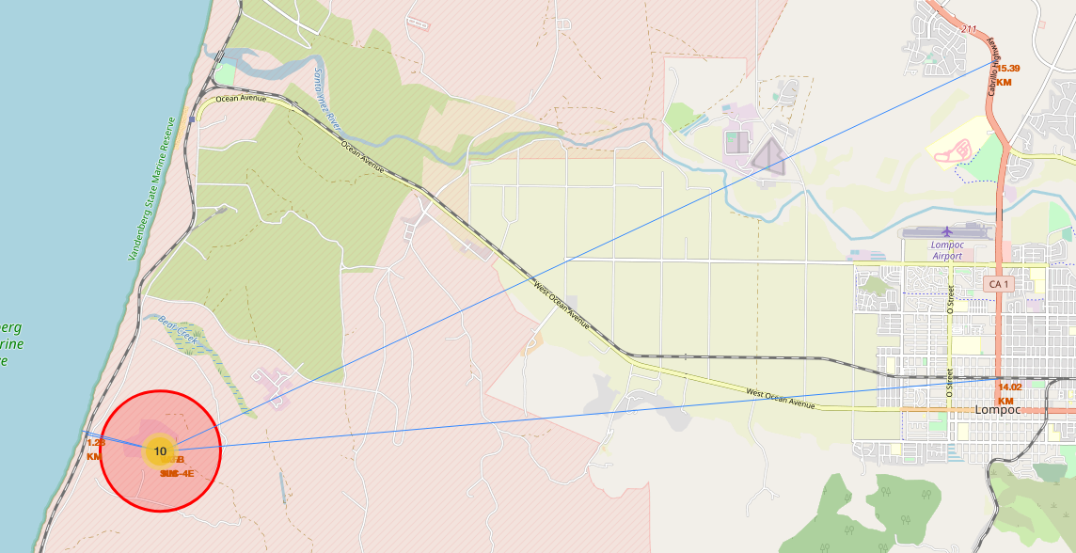
VAFB SLC-4E Proximity to Civilian Infrastructure
As shown the launch site is quite close to the coast the distance of only a bit over a kilometer to a coast and a railway, however, it is quite distant from the closest city and highway.

Slide 48

Section 4

Slide 49
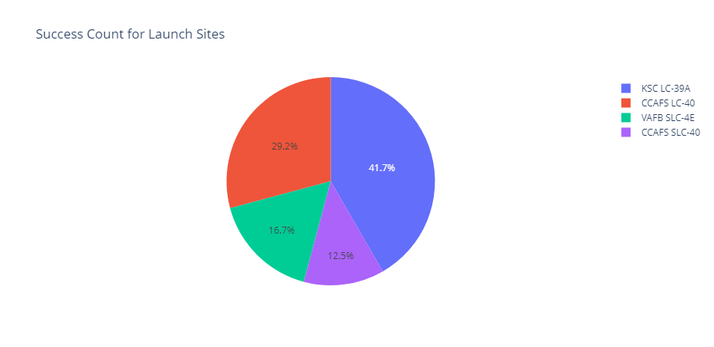
Launch Sites Success Rate
The highest rates among all four launch sites is site KSC LC-39A, it is located on the Florida coast, west ward of the two other coasts located there as well.
The least successful site is CCAFS SLC-40.

Slide 50
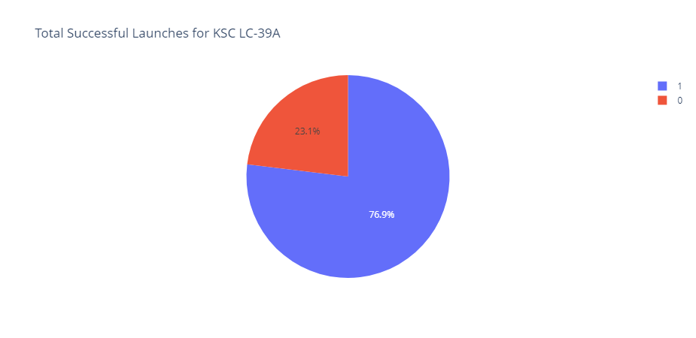
Highest Success Rate Launch Site: KSC LC-39A
The launch site KSC LC-39A has the highest success to failure ratio standing at 79.6%.

Slide 51
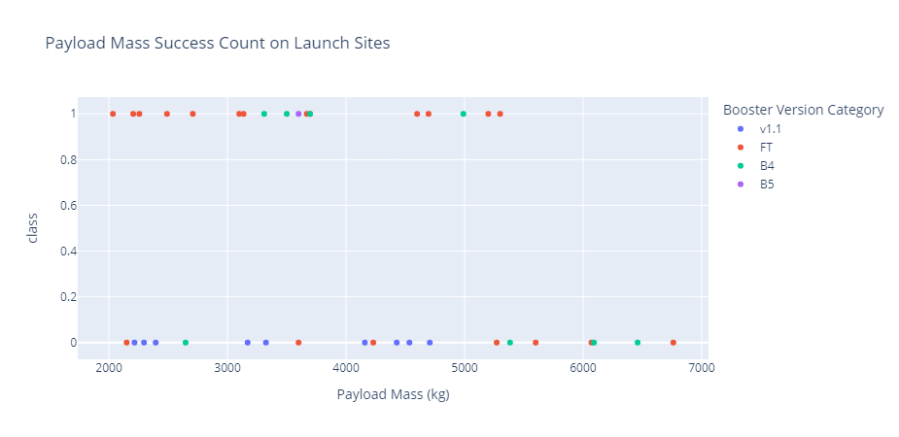
Payload Mass Success Count
Based on its payload we could see that the booster with payload less than 4000 is that has the version of FT, B4, and B5 has high success rates, while booster v1.1 has not succeeded at all.

Slide 52

Section 5

Slide 53
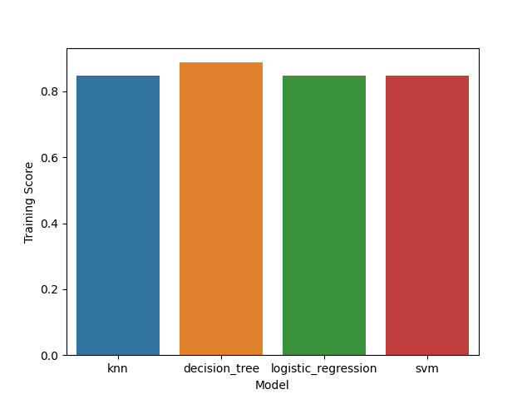
Classification Accuracy: Training Scores
Among all models that were created, the Decision Tree Model created the model that works best with the Training Data.

Slide 54
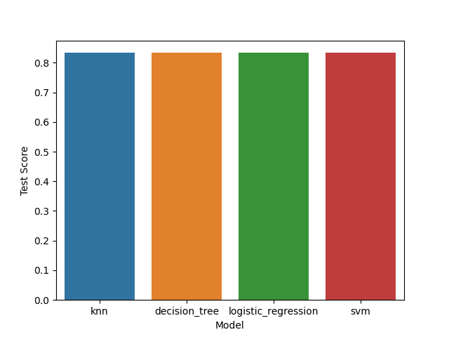
Classification Accuracy: Testing Scores
During testing, we found out that all models work the same with all receiving test scores of 0.8333.

Slide 55
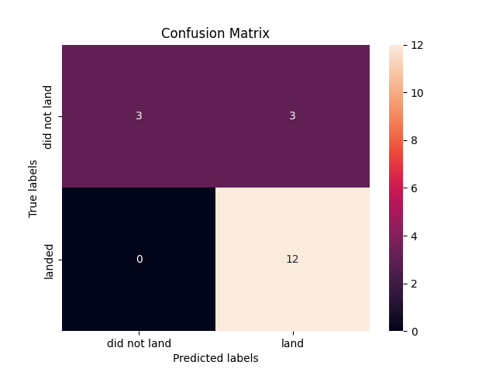
Confusion Matrix
When we look deeper into the confusion matrix, we see that all four models produced the exact same matrix.
They received 100% accuracy on True Positives, but only 50% accuracy with True Negatives when compared to False Positives.

Slide 56
Conclusions
We found out that all launch sites are in extremely close to the equator and the coasts.
SpaceX started the Falcon9 with a rocky success rate, but it started to stabilize and became more successful as launches increase.
The most successful launch site is the KSC LC-39A launch site.
The Falcon 9 has transported 45596 kilograms worth of payload among the data provided in the data set.
Most of the launches are made with a payload of around 7500 kg or less.
SpaceX launched most of its payload to LEO, ISS, PO, GTO, and VLEO type orbit.
With the model we have created, we are only able to accurately predict the outcome only 83.33% of the time.

Slide 57
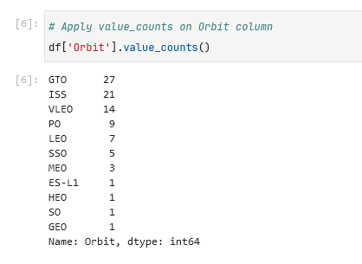
Appendix
The GTO orbit type, has the highest number of payload sent to.

Slide 58


